Slide 1

Examination Management System

Slide 2

introduction
In education, the concept of E-Learning (Electronic Learning) has grown rapidly. Organizations around the world are trying to move from a paper-based environment to a paperless environment. Traditional examination systems pen and paper are used which require more effort on the part of students and instructors. Computerized examination system are considered an important source for university and institutes exams. There are many benefits for adopting computerized examination management system. Examination management system saves time especially in case of huge number of students and provide a digital accurate evaluation free of human mistakes.

Slide 3

Why Examination management System
Stored Repository of exams
General problem with time for students
Auto grading
Flexible
Time Saver
Security
Develop a system which allows the faculty to create, modify and store questions which can be grouped together to form sections and these sections can be grouped together to form tests/examinations.

Slide 4

Literature Survey : EXISTING SYSTEM
The whole process of assigning test and evaluating their scores after the test, was done manually till date. Processing the test paper i.e. checking and distributing respective scores used to take time when the software was not installed.

Slide 5
Disadvantages of Current System
The current system is very time consuming.
To take exam of more candidates more invigilators are required but no need of invigilator in case of online examination.
The chances of paper leakage are more in current system as compared to proposed system.
Result processing takes more time as it is done manually.

Slide 6
Objective
examination management system will reduce the hectic job of assessing the answers given by the candidates manually .
Being an integrated examination management system it will reduce paper work .
To allow faculty to give additional time to students with disabilities .
To allow faculty and other institutions to create tests and answer key.
To allow automatic grading and manual grading which can be recorded per test.
Random generation of test question Timed exams .
The result will be shown immediately to the participating students
The project allows faculties to create their own test . It would enable educational institutes to perform tests and quiz .

Slide 7
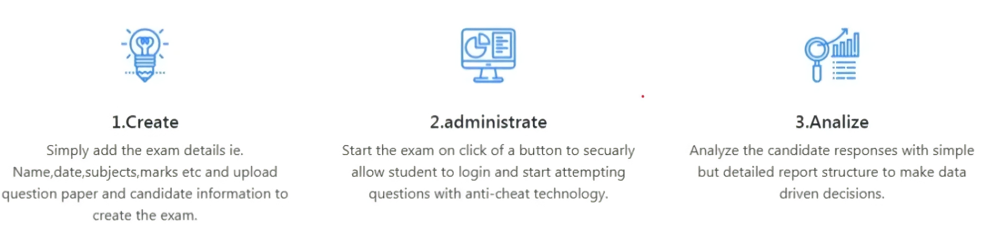
How To Use :

Slide 8
System Description :
Computerized examination system depends on three types of users to make its functionality in a good way. Examination management system provide an automatic way to evaluate students to make the evaluation process free of human mistakes. It’s also provide a good environment to examiners to easily manage their exams and maintains confidentiality of exams. It also provide a good computerized environment to students to enter the exams in a valid date and time and answer questions smoothly then review their questions and finally see the correction of exam questions to know their mistakes. This system can be installed in examination centers, colleges, schools and courses centers.
Now each module in the examination management system will be explained in more details

Slide 9
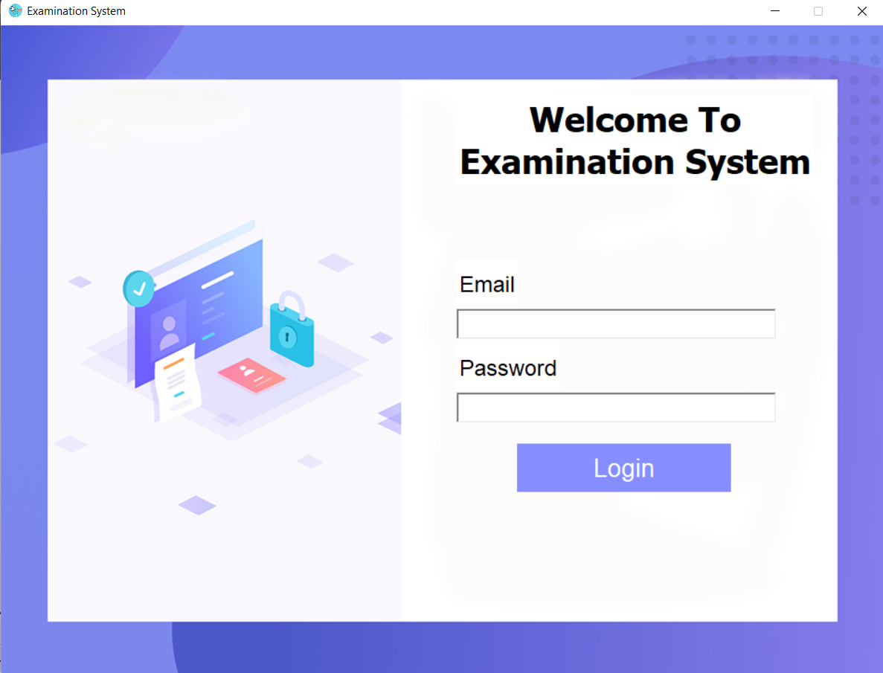
- Login module:
This module will be at the beginning of the system. It will ask users to enter their email and password. Firstly it will check the email it’s valid or not then the system will use the user email to identify his role if the user is an existing member the system will be available to user for using it upon its role but if it isn’t an existing member the system will prompt an error message to ask the user to enter a valid email and password.

Slide 10

Admin will use his ID to use the system with help of his national number. At admin module there will be four frames to ease its use and make its functionality in a good ways .
- Admin module:
10

Slide 11

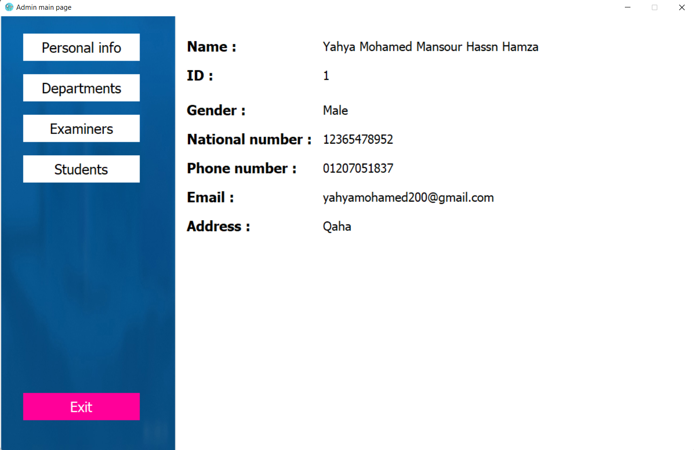
First Frame
Personal information frame :
This part of the admin module prompts all his personal information upon the admin id. For moving to any other frame admin only should choose the frame name from the buttons listed on the left on the window.
Place your screenshot here

Slide 12
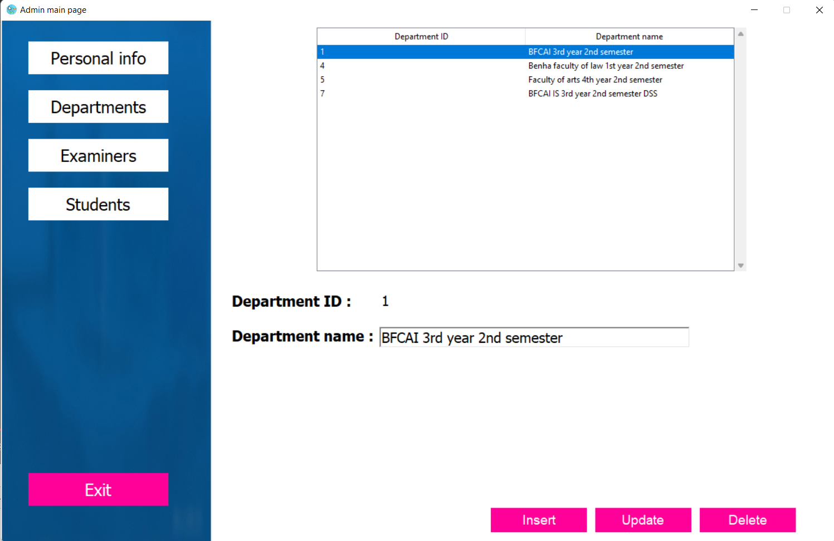
Second Frame
Departments frame:
At this frame the admin can manage all departments’ data to use them in another frames in examiners and students’ data. Managing data here mean that he can insert, update, delete and show them.

Slide 13
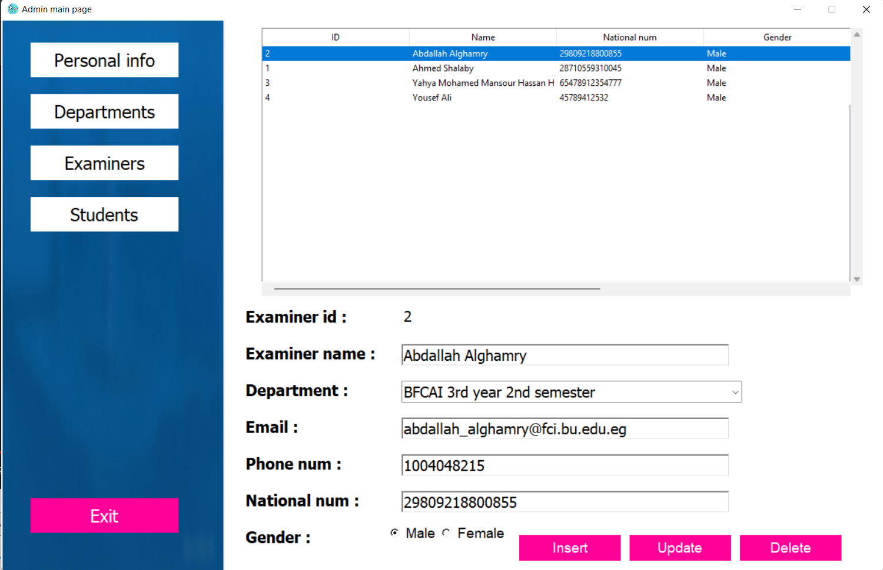
Third Frame
Examiners frame :
At this frame all examiners data are managed by the admin (insert, update and delete). Departments are assigned here to examiners. All records shown here are ordered upon the examiners departments and their names. If the admin chooses any department from the combo box only members from this department will be shown in the table ordered upon their names to ease the use of the system when dealing with much data.
Place your screenshot here

Slide 14
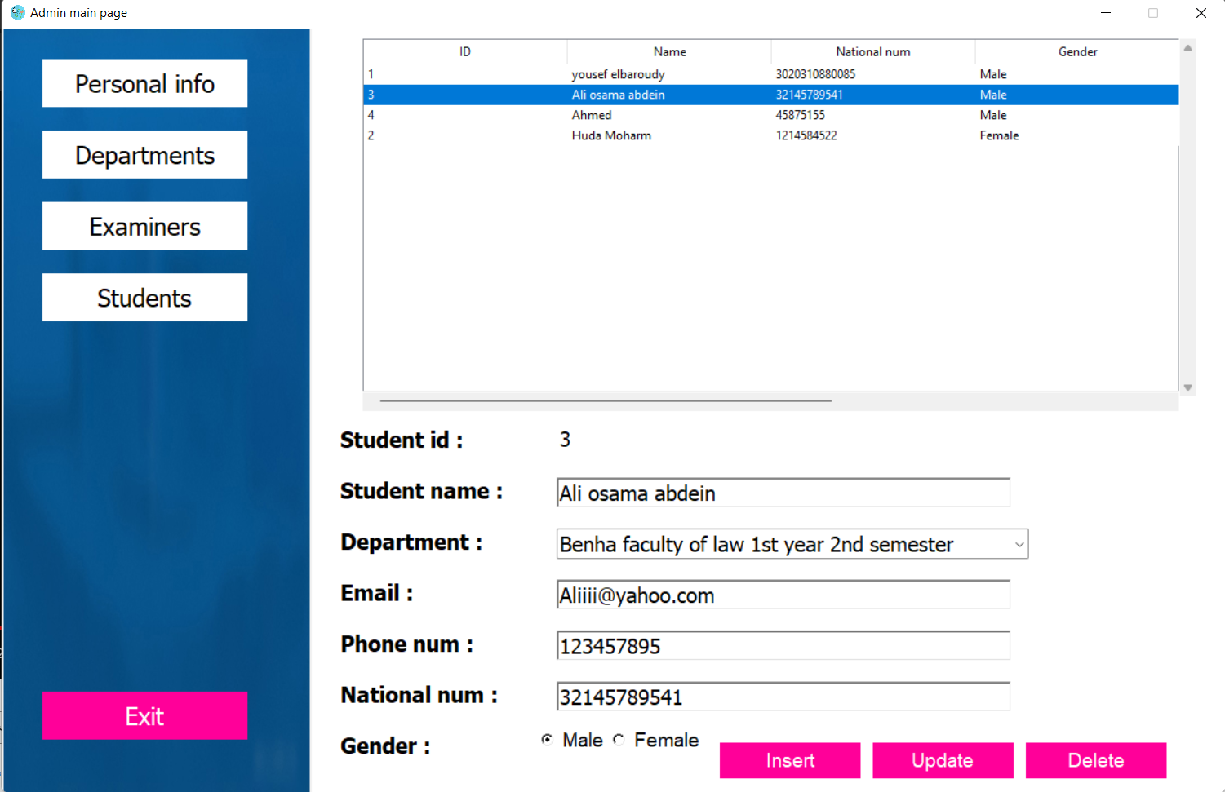
The Last Frame
Place your screenshot here
Students frame :
At this frame all students data are managed by the admin (insert, update and delete). Departments are assigned here to students. All records shown here are ordered upon the students departments and their names. If the admin chooses any department from the combo box only members from this department will be shown in the table ordered upon their names only to ease the use of the system when dealing with much data.

Slide 15

- Examiner module:
Examiners will use their id and their national number to use the system. This module also contains four frames to ease the use of the system and make it clear. Like admin module the firs frame will display the personal information of the examiner. The second one helps examiners to manage exams information like name, beginning date, beginning time, finish date, finish time and the total degree of the exam. Many tools and techniques used in this frame to decrease number of mistakes done by human like entering an invalid dates and times so a calendar and a digital clock widgets and algorithms used here to handle this area to be free of mistakes. The third frame used to manage questions of exams easily the examiner select an exam from his exams then its questions will be displayed in a table then he can manage all exam questions.

Slide 16
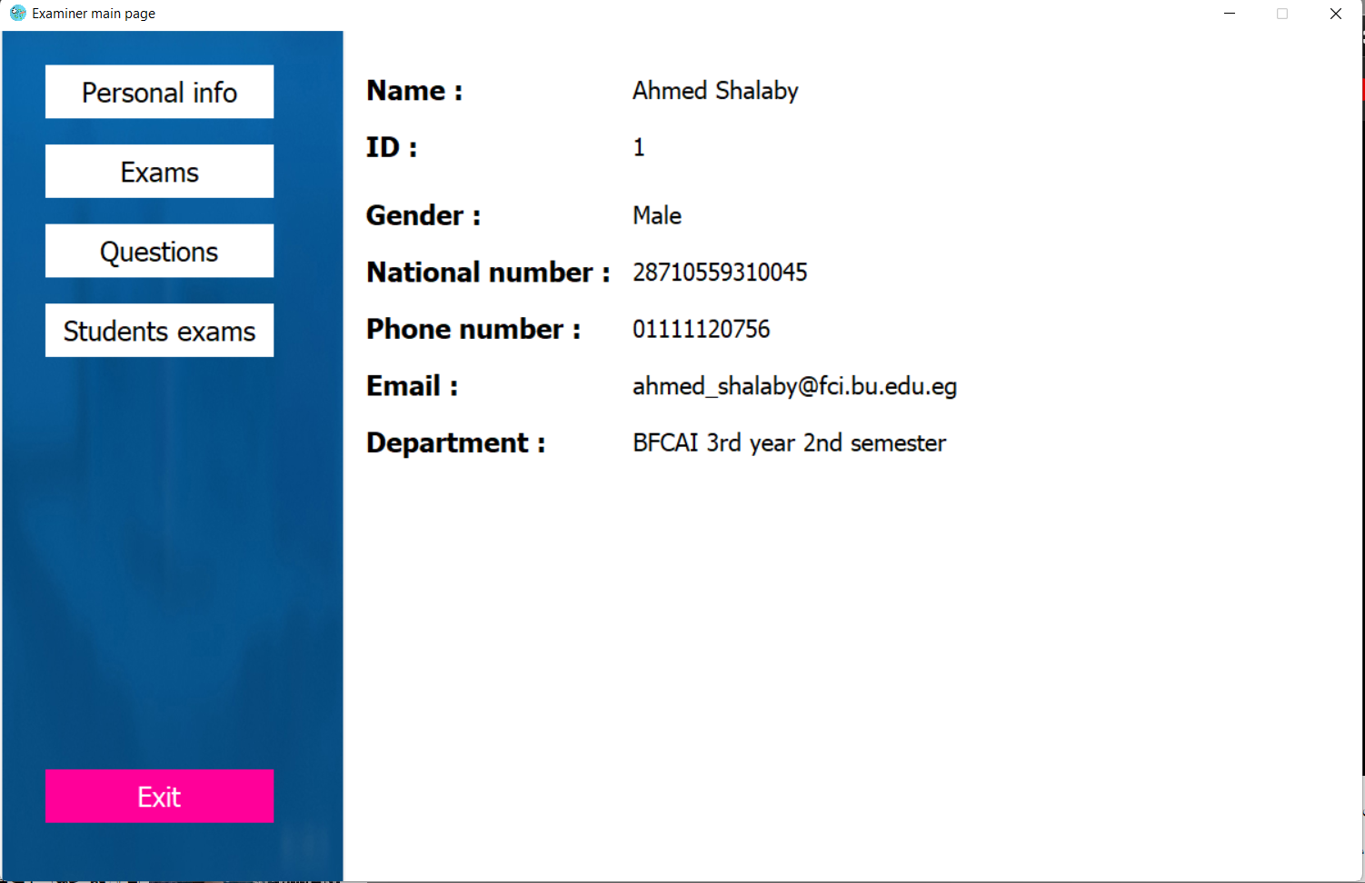
This part of the examiner module prompts all his personal information upon the examiner id. For moving to any other frame examiner only should choose the frame name from the buttons listed on the left on the window.
Place your screenshot here

Slide 17
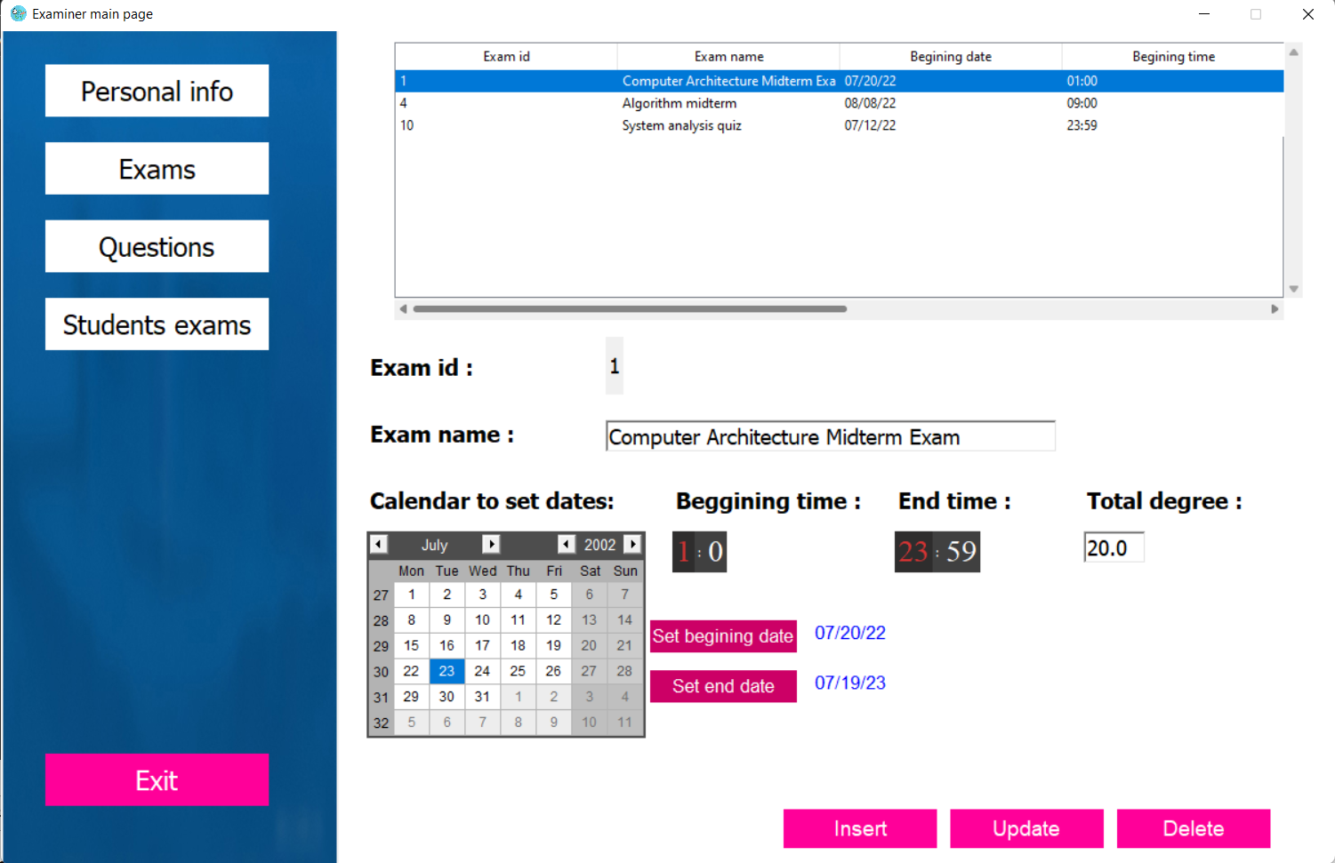
At this frame the examiner can manage exams information. To enter the dates of the exam examiner should use the calendar to put valid dates then press “Set beginning date” or “Set end date” to set the dates of the exam. With the help of digital clock examiner can enter exams beginning and end times. Then the total degree of the exam. If there is any problem with entered data the system will ask the examiner to enter a valid data.

Slide 18
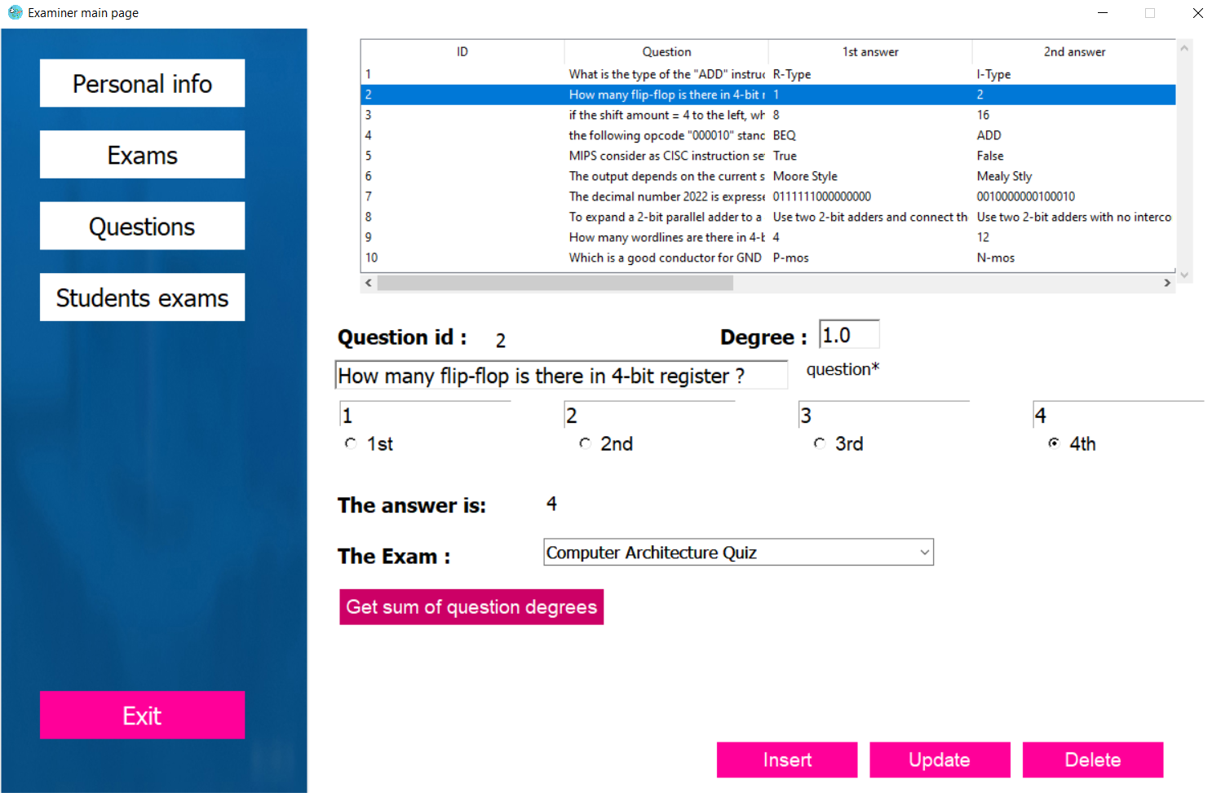
Firstly the table in this frame will be empty. After selecting an exam from the combo box only questions in this exams will be displayed on the table. Now the examiner can put questions to the exam and identify the correct answer of each one and its degree. The examiner can know the sum of degrees of the questions to be informed how many questions left to complete the exam total degree.

Slide 19
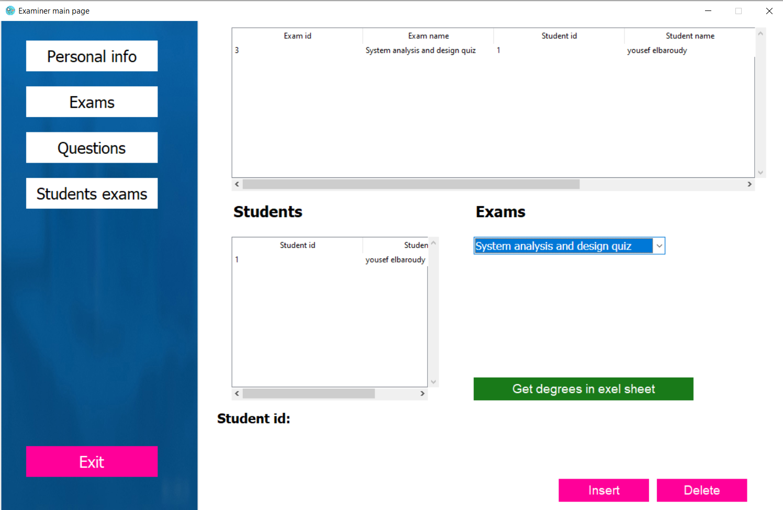
Firstly the table which identify students’ degrees in this frame will be empty. After selecting an exam from the combo box the degrees of the students with their names will be displayed on the table ordered upon their names if there is any student doesn’t do the exam his name will be displayed at the end of the table. If the examiner wants the degrees of particular exam they can download it in excel sheet form after choosing a particular folder.

Slide 20
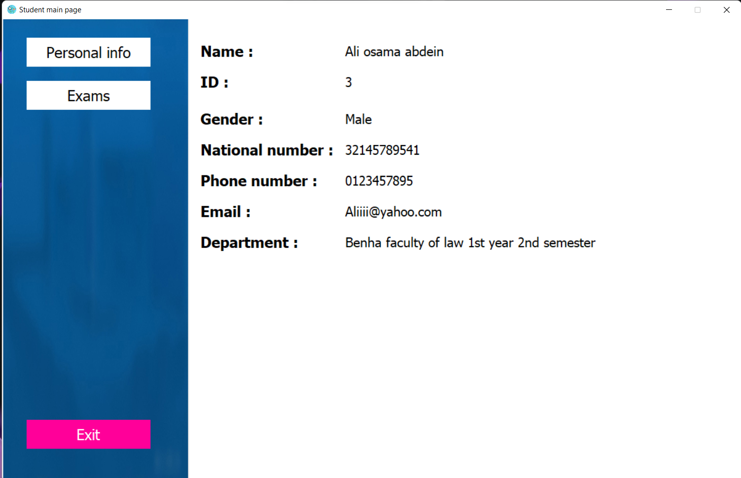
Student module:
Students will use their id and national numbers to use the system. This module contains two frames. Like previous modules the first frame will show student personal information. The second frame will show student exams with their information like dates, times, degrees and status of each exam. The status will show if the exam is done or not. The student can choose an exam from this field only valid exams will be opened to him and move the student to exam modules. After doing the exam the student will be returned in this page and see his degree and he cannot open the same exam again.
20

Slide 21

Exam modules:
The first exam module will be opened to the students who choosing a valid exam upon examiner rules. It will show exam questions randomly so questions order will be different from student to another to prevent cheating. This module will provide next and back on questions to ease the examination mechanism. After doing the exam in the first module the second module will be opened . This module show all questions with student answers to provide another way of reviewing an exam if there is any problem with any question easily the student can choose it and a third module will be opened to edit the answer.

Slide 22
After this process the second module will be opened again for doing its task. After reviewing all questions student can submit the exam. After submitting the exam the fourth module will be opened and it will show student total degree and the correct answer of each question compared to the student answer. After checking all degrees and answers students can easily return back to the student module.

Slide 23
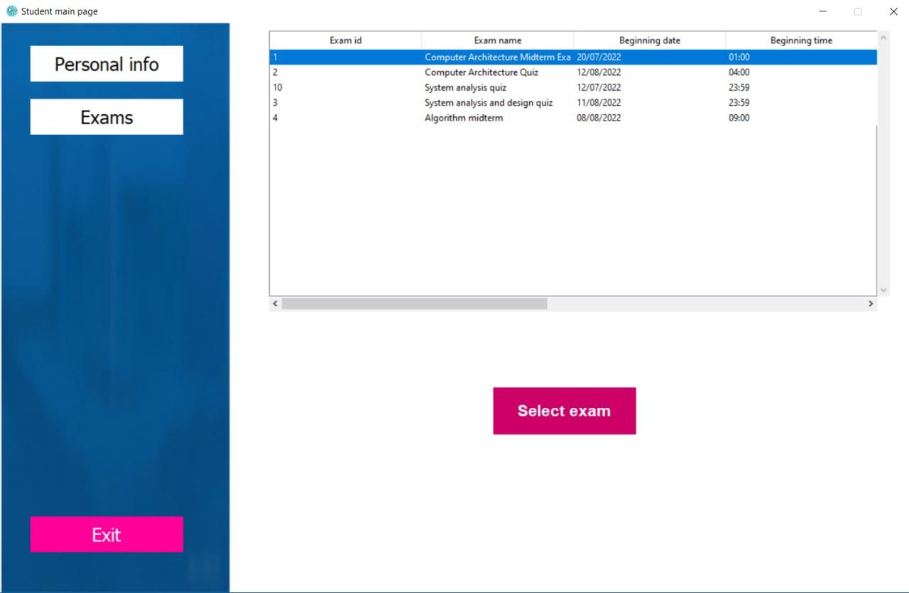
This part of the module show exams inserted to the student with the status of the exam and student degree if the student done the exam. All exams appeared here are ordered upon their dates. After selecting a valid exam the exam window will be opened to the student.
Place your screenshot here

Slide 24
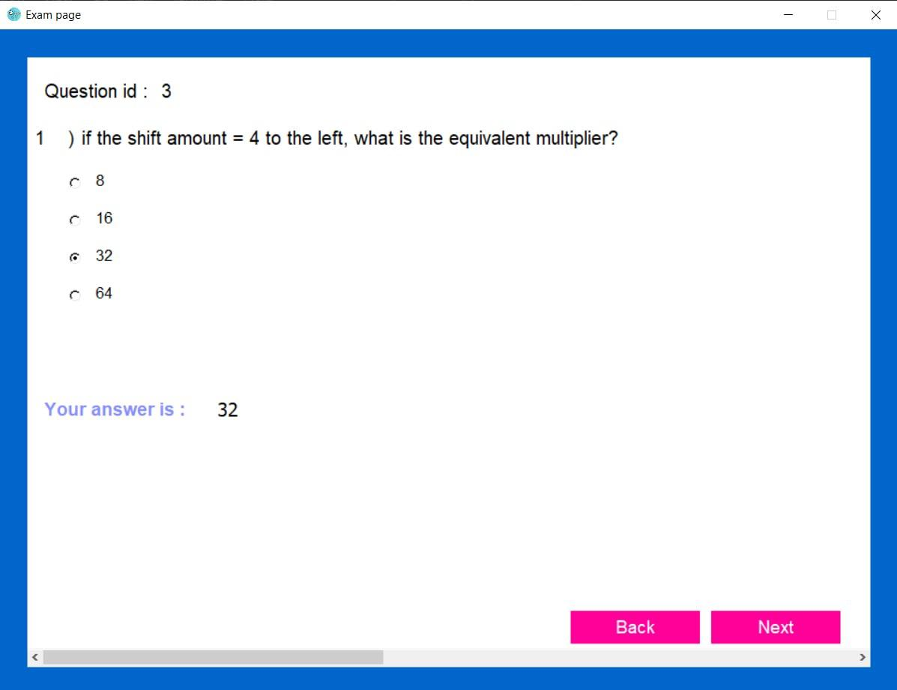
All exam questions are appeared here to be answered by the student. Questions are shown in a randomized way to decrease cheating. Students can go next and back on questions for easing the examination mechanism. After finishing the exam a new module will be opened for reviewing answers and students will have another chance for correcting their answers. If there is any problem and the computer turned off and the student doesn’t finish the exam the student will find all his answers after open the exam again in the valid time and he can complete it smoothly.

Slide 25
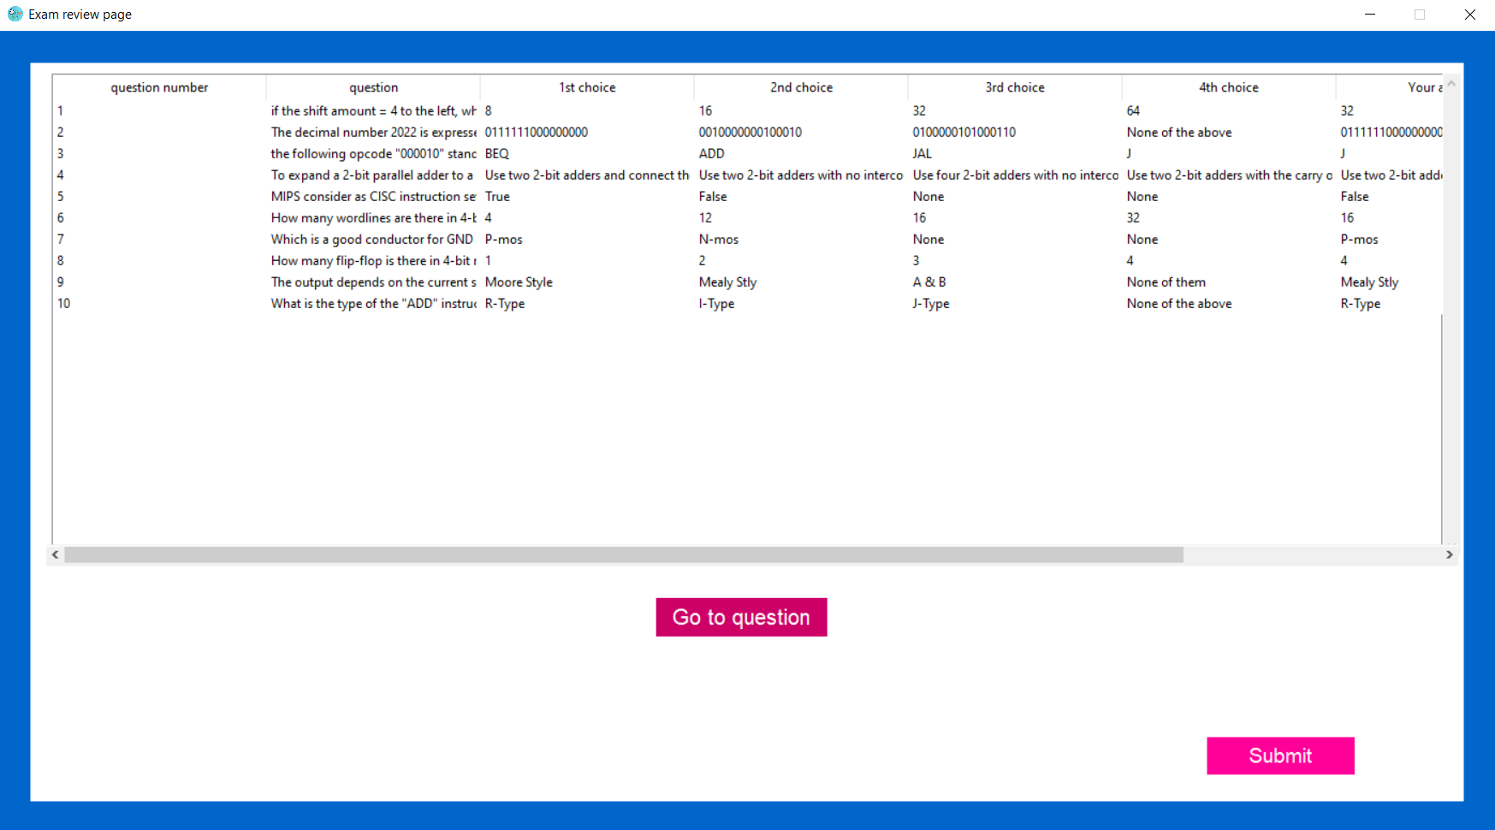
This module will be opened after the exam questions module to open a new chance for students to correct their mistakes. Easily if there is a problem with any question student can choose it and push ”Go to question” button and new module will be opened to the student to answer the selected question. Note that all questions appear in this module are in the same randomized order appeared in the exam module.
Place your screenshot here

Slide 26
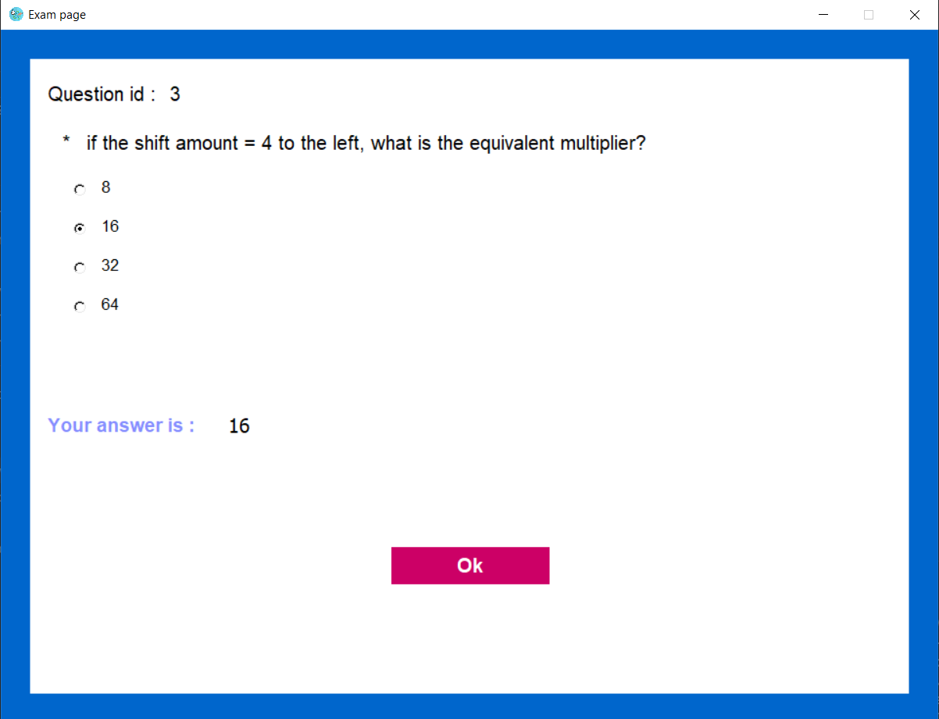
This module will be opened to the student from the reviewing module after selecting a question to answer it again if there is a problem. After pushing” Ok ”button student will returned back to the reviewing questions module and he can repeat this process with any number of questions.

Slide 27
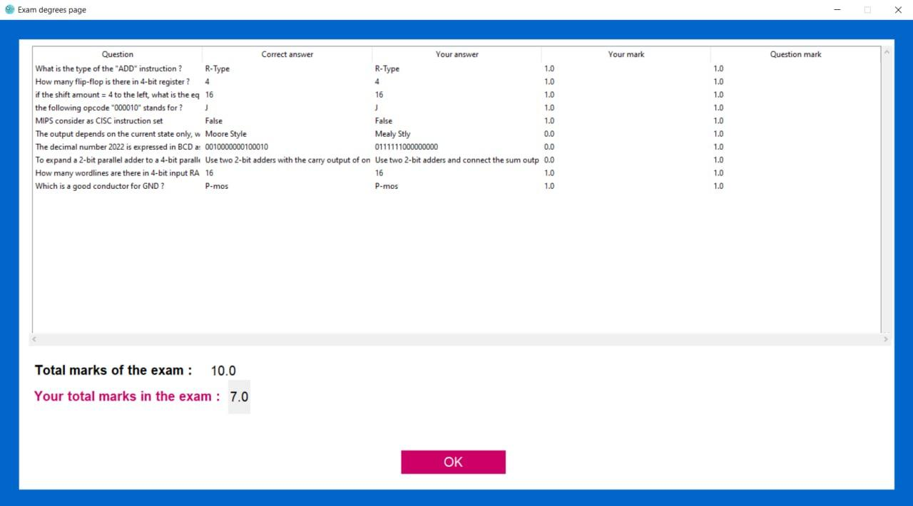
At this part students will be informed with their mark in the exam and each taken degree in each question. Also the correct answers will be shown to them. After clicking “Ok” button the student module will be opened again and the status of the exam will be changed and the student mark.
Place your screenshot here

Slide 28
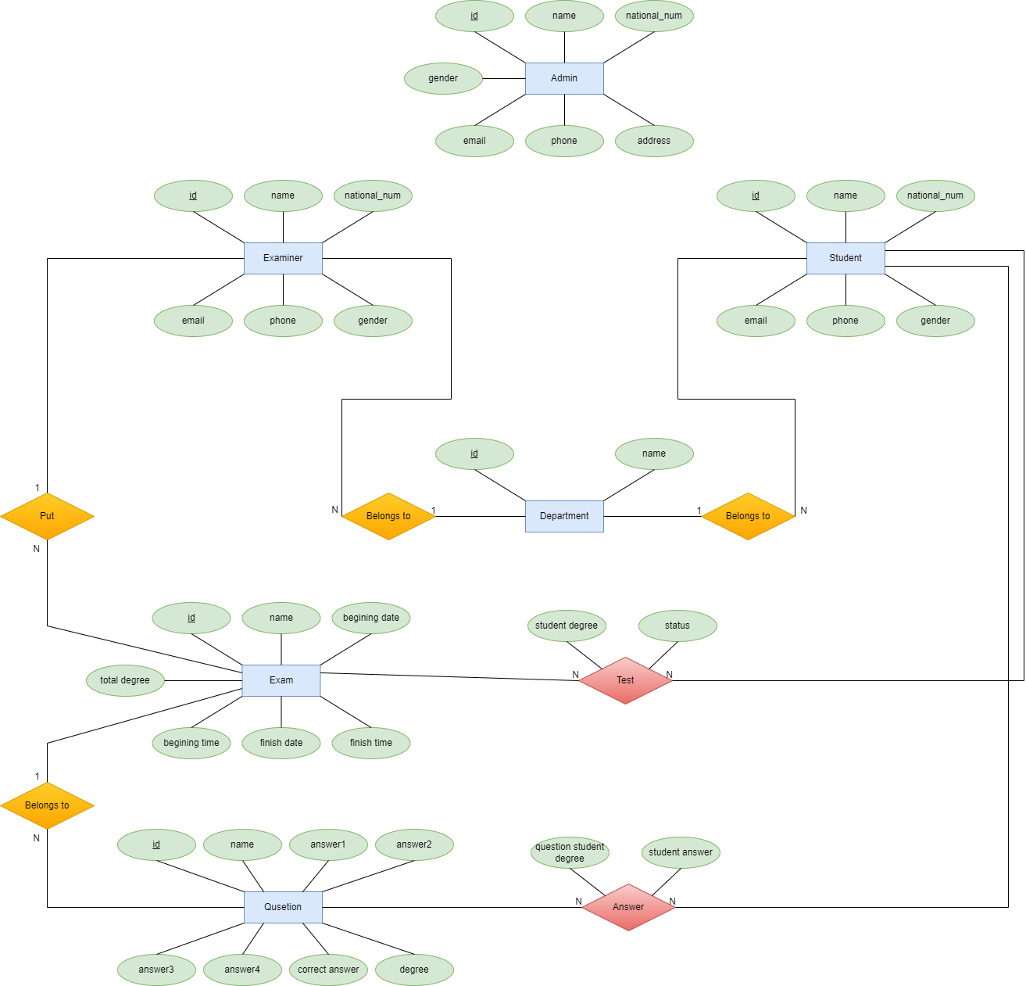

Slide 29
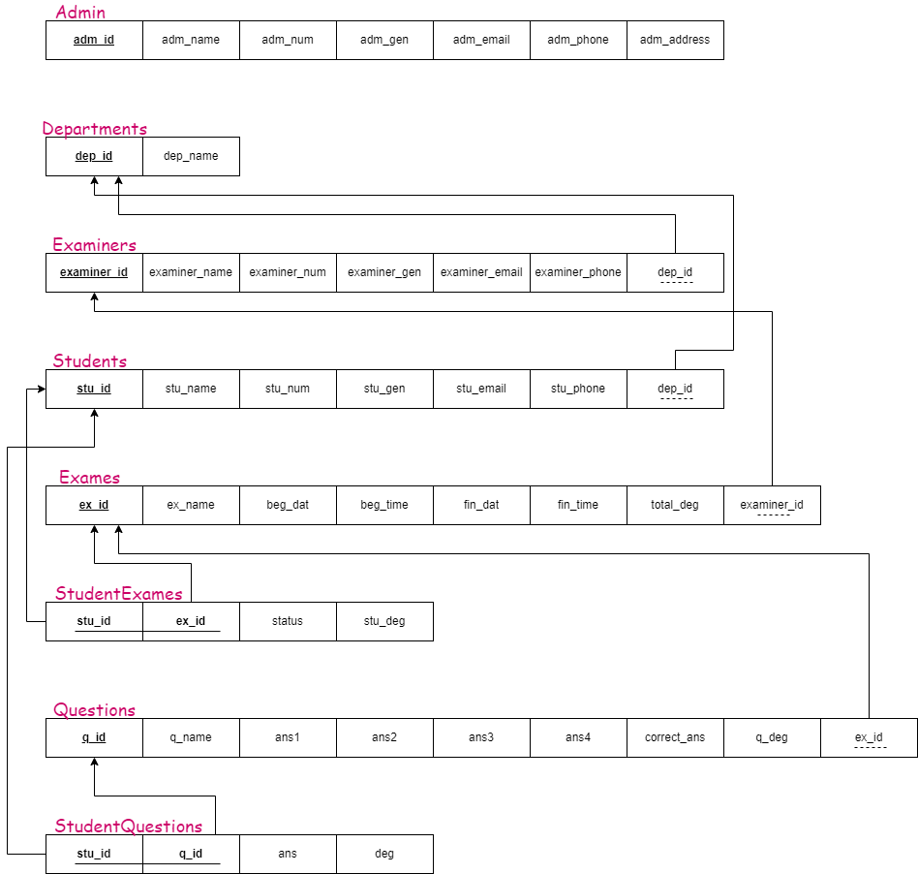

Slide 30





Team Presentation
Yahya Mohamed Mansour Hassan Hamza
Yousef Tarek Abdelmaboud Elbaroudy
Yousef Ali Ahmed Abd elmajeed Mohamed
Huda Mohammed Abd El_Fattah Mohammed
Ali Osama Abdien Omar
28

Slide 31
Thank You

